Slide 1
Experimental Design
MurD inhibition
1 mM
>80%
Assay interference
checks
PASS
MurE inhibition
1 mM
Becca Steventon, University of Warwick

Slide 2
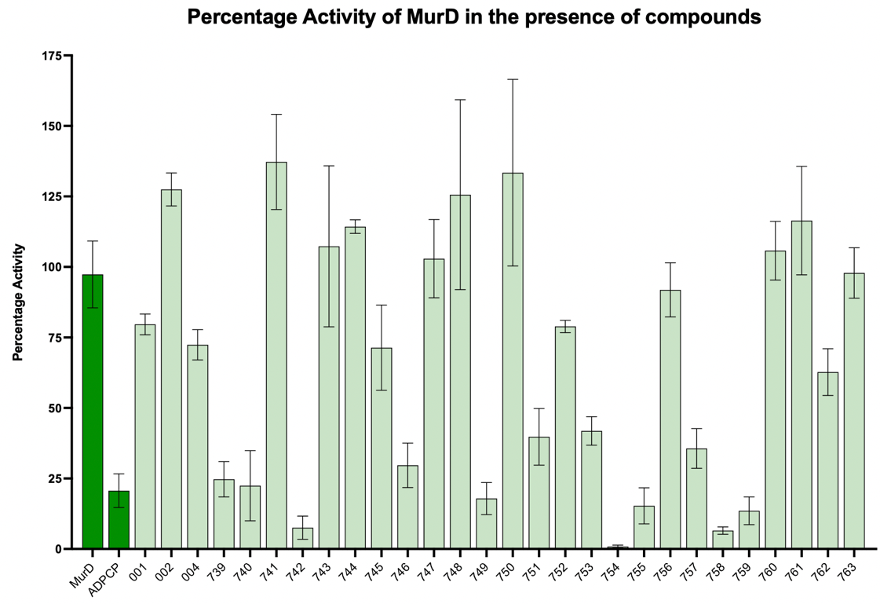
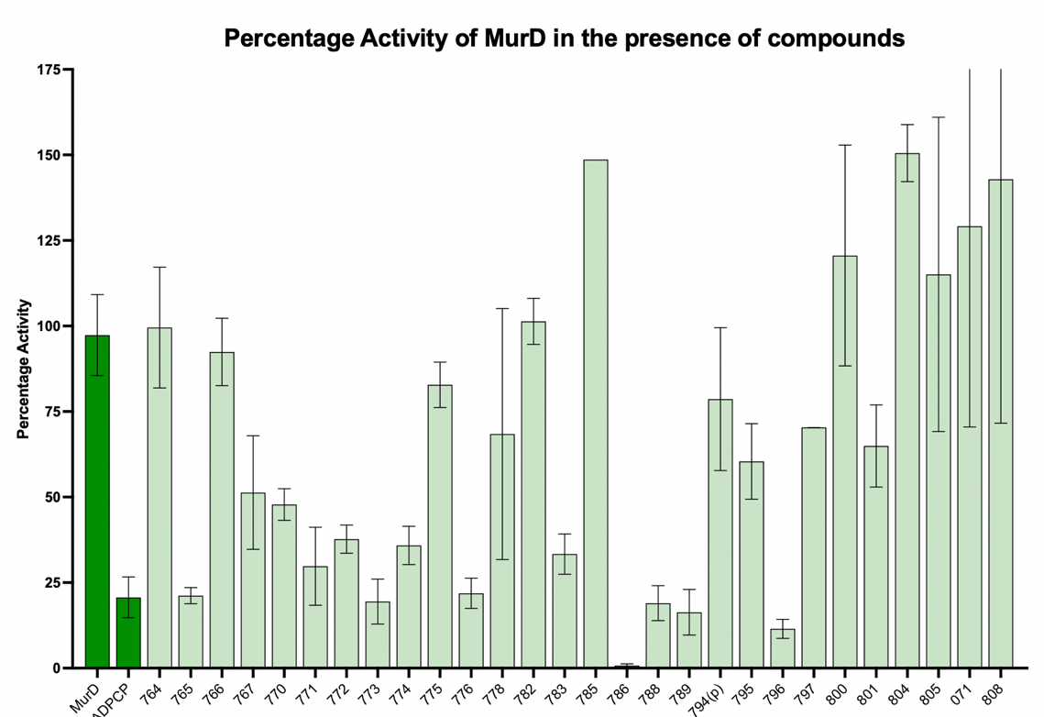
MurD Inhibition
Becca Steventon, University of Warwick

Slide 3
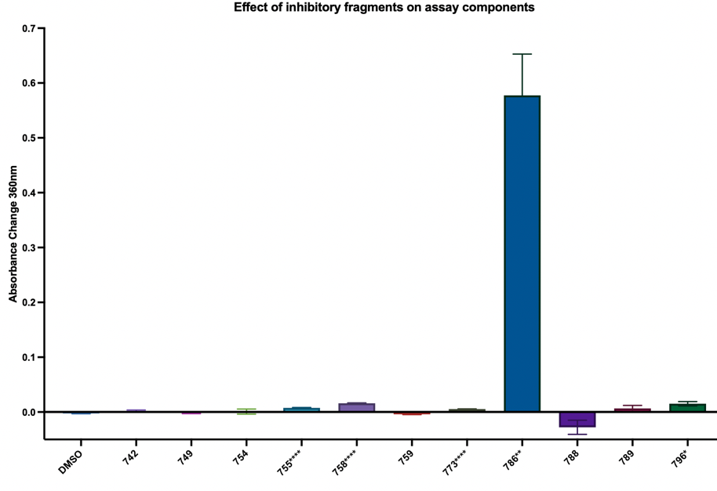
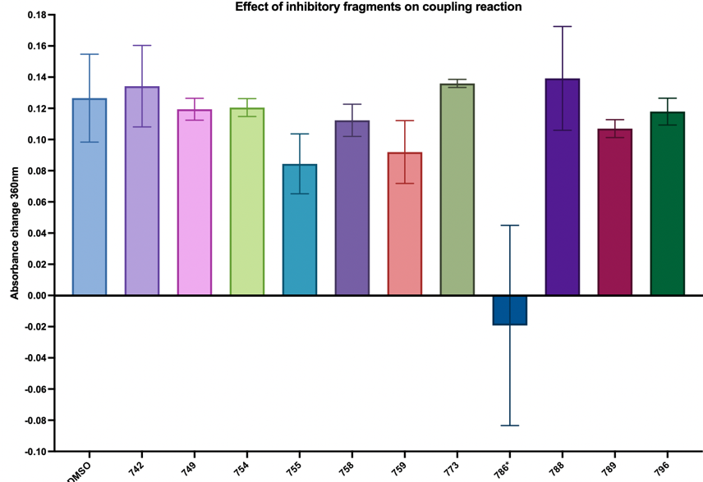
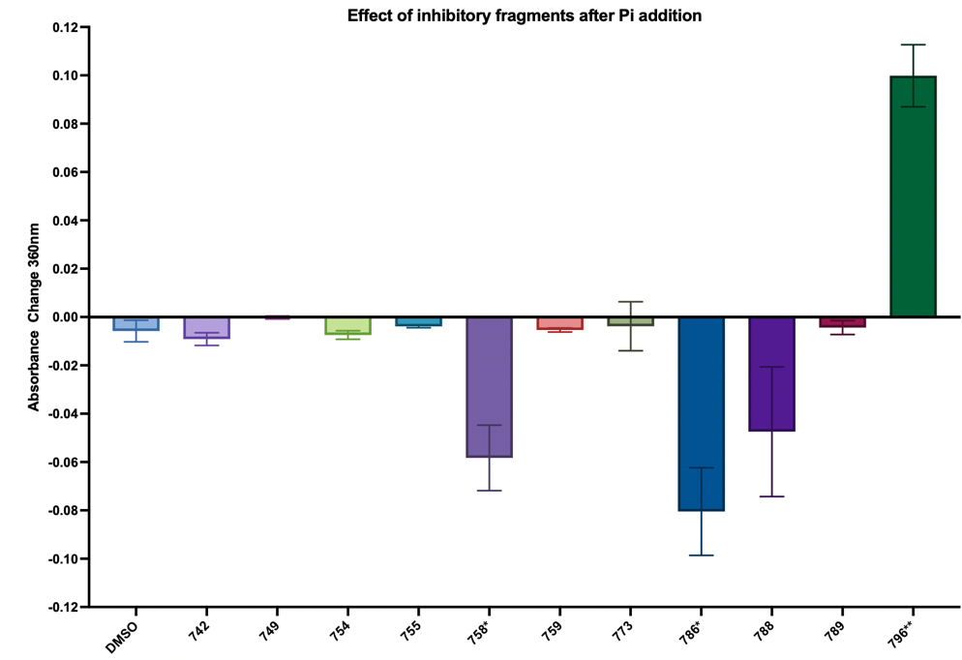
Assay Interference
Becca Steventon, University of Warwick

Slide 4
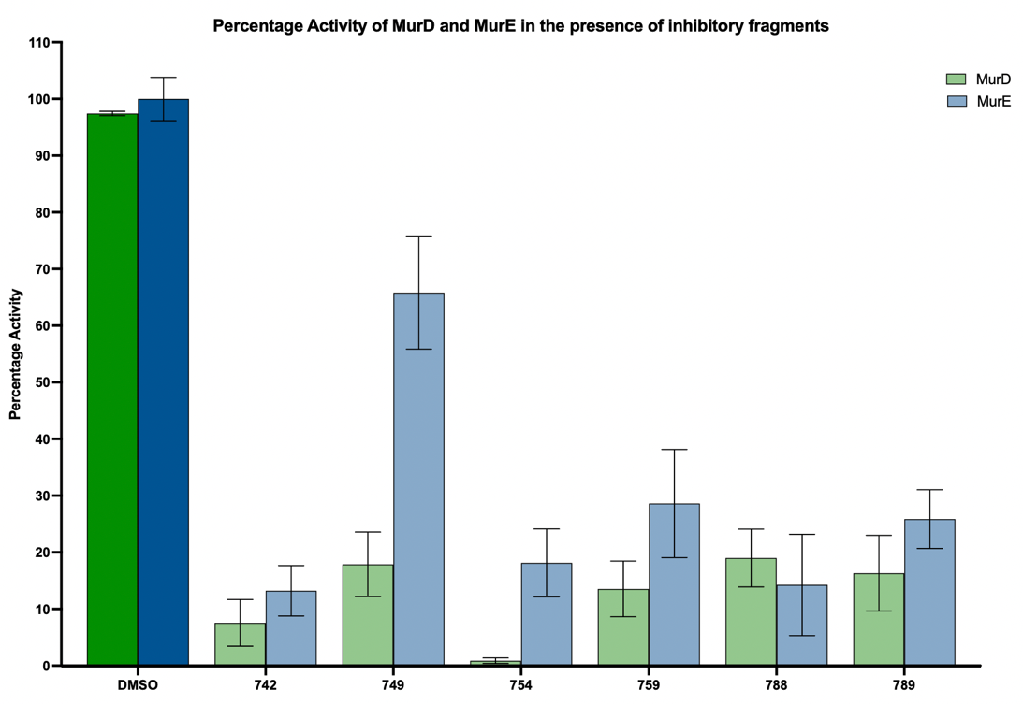
MurE Inhibition
Becca Steventon, University of Warwick

